Slide 1
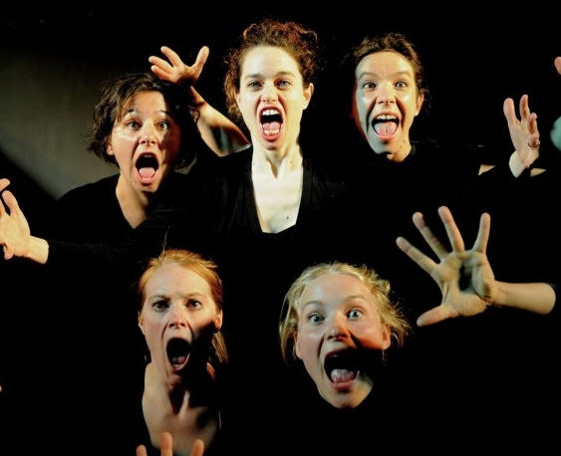
PHYSICAL THEATRE
Year 8 Drama
Lesson 5
Using characterisation to perform an extract of script

Slide 2
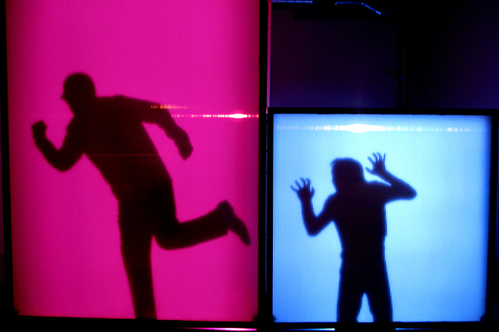
LESSON OBJECTIVE:
To perform an extract of script using exaggerated characterisation

Slide 3
KEYWORDS
Lesson Objective:
To perform an extract of script using exaggerated characterisation
To perform using physical theatre techniques
Physicalisation
Characterisation
Exaggeration

Slide 4
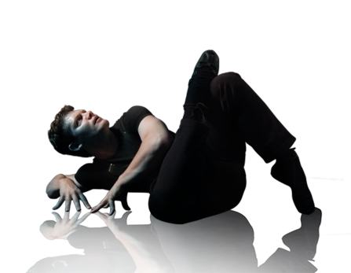
EXAGEREGISTER
Lesson Objective:
To perform an extract of script using exaggerated characterisation
To perform using physical theatre techniques
When students answer the register, they have to show an over-exaggerated facial expression

Slide 5
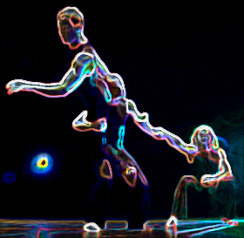
RECAP
Lesson Objective:
To perform an extract of script using exaggerated characterisation
To perform using physical theatre techniques
Recap on last lesson
Exaggeration / choreographed movements
Characters are a type:
Greed
Angry
Upset

Slide 6
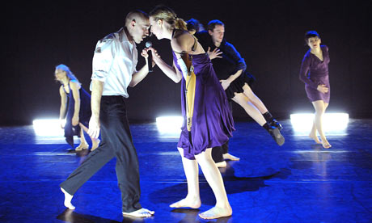
CREATING OBJECTS
Lesson Objective:
To perform an extract of script using exaggerated characterisation
To perform using physical theatre techniques
Teacher calls out name of an object and a number – students have to group in the number and create the object using everyone in the group.
Must include a movement and sound effect
WARDROBE
DIGGER
TELEVISION
HAT
WASHING MACHINE

Slide 7
CREATING A STORY
Lesson Objective:
To perform an extract of script using exaggerated characterisation
To perform using physical theatre techniques
In groups of 5, students are given the story of Little Miss Muffet.
Students must perform this, considering the function for each character e.g. the spider = to scare, Miss Muffet = is scared, pathetic
Actions and speech must be relevant to the type of character
PHYSICAL THEATRE REQUIRES EXAGGERATED VOLUME AND VISUAL PERFORMANCE

Slide 8
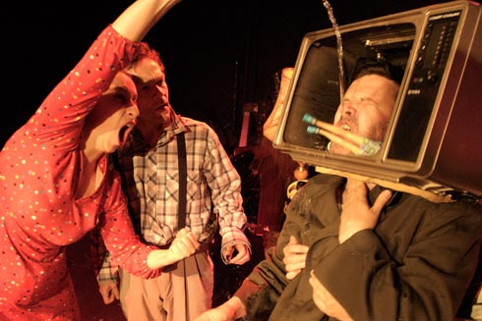
PERFORMANCE & PEER EVALUATION
Lesson Objective:
To perform an extract of script using exaggerated characterisation
To perform using physical theatre techniques
Each group performs the story of Little Miss Muffet to the rest of the class.
Each group is allocated one other group to evaluate – they use their checklist to mark against.

Slide 9
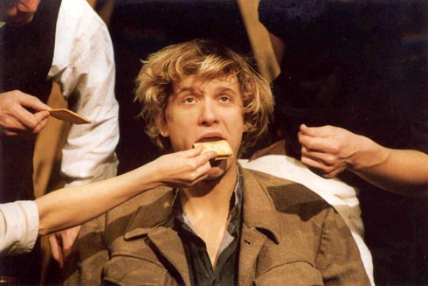
FEEDBACK
Lesson Objective:
To perform an extract of script using exaggerated characterisation
To perform using physical theatre techniques
Each group feeds back to the other group using WWW & EBI
Each student then sets themselves a target to work towards for their assessed piece of work
Each target is written on a post-it note to revisit in the next lesson

Slide 10
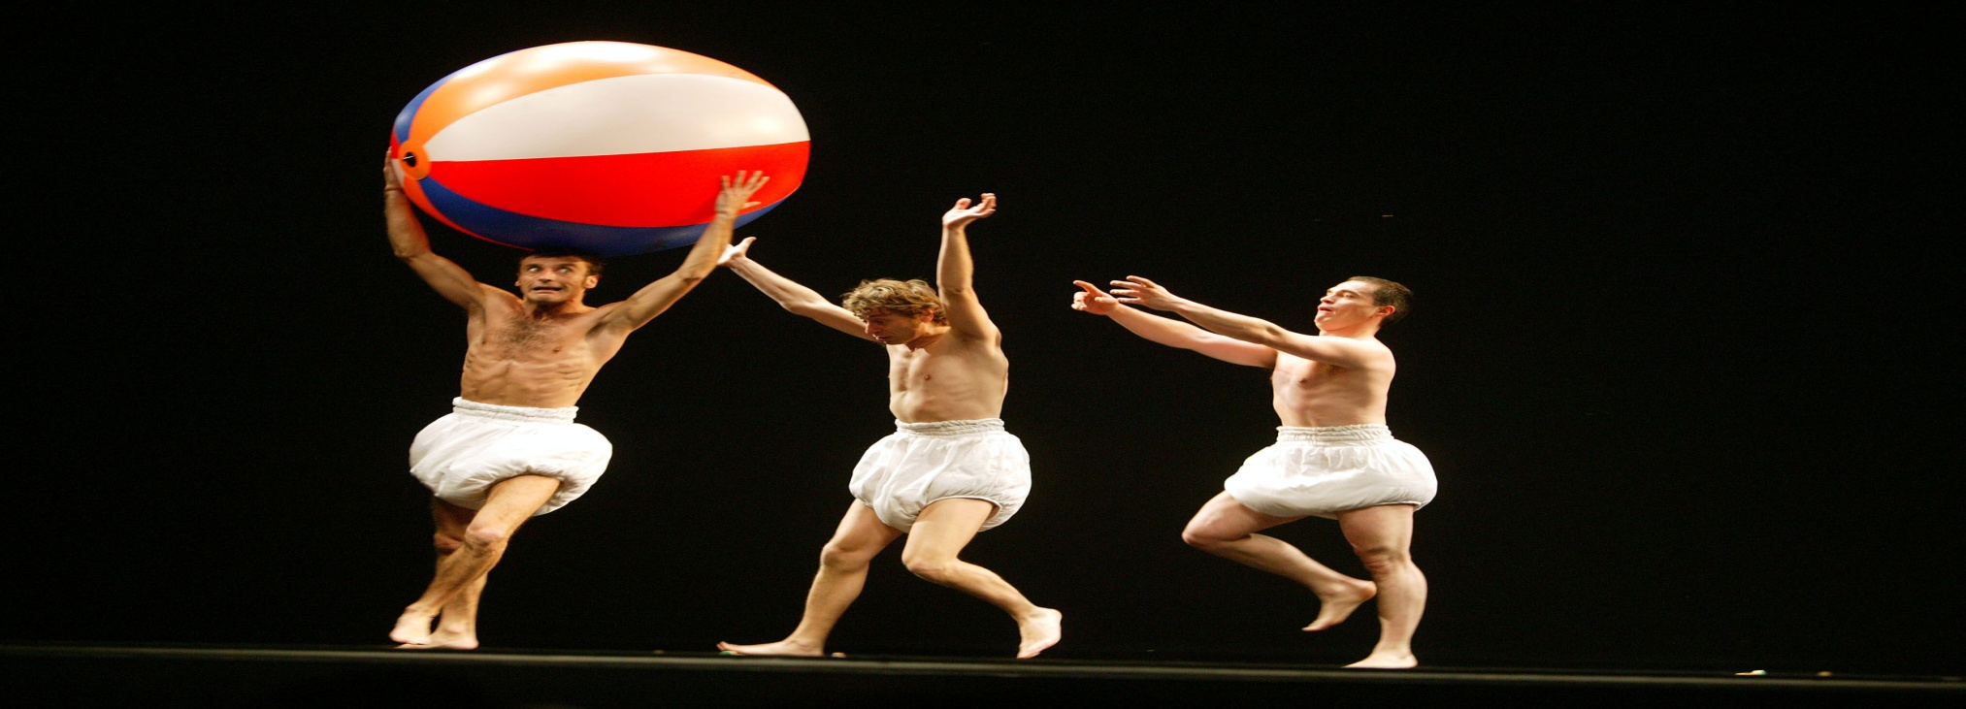
TARGETS
Lesson Objective:
To perform an extract of script using exaggerated characterisation
To perform using physical theatre techniques
Each student reads allowed their target for their assessed piece.

